Slide 1
Class 8: MR Types and Formats

Slide 2
MapReduce Job components
MapReduce Types – Key type and Value type
Data types (discussed in class 5)
MapReduce Formats – Input Format and Output Format
Data Formats – flat files to databases
Input Split and Records
Mapper, Reducer and Combiner
map and reduce functions
Setup and cleanup methods
Partitioner – getPartition method
Context – write(keyout,valueout) function

Slide 3
MapReduce Types
Map and Reduce functions in Hadoop MapReduce have the below form.
map(k1,v1) -> list(k2,v2)
reduce(k2,list(v2)) -> list(k3,v3)
The reduce input must have the same type as the map output.
The context objects are used for emitting key-value pairs.
Context.write(keyout key, valueout value) throws IOException, InterruptedException
Combiner function should be of the same form as the reduce function.
Partition function operates on the intermediate key and value pairs(k2,v2), it returns partition index. – Note: partition is depends only on KEY.
Partition – (k2,v2) -> integer.

Slide 4
Input types are set by – Input format
E.g. TextInputFormat – generates keys of LongWritable and values of Text type
Output types or other types are set by Job methods.
Mapper is a generic type. Generic type allows it to work with any key or value types.
Default Partitioner is HashPartitioner. This class apply hashing function to key to determine which partition the record belongs in.
No. of partitions is equal to no of reduce tasks for the job.
By Default there is a single reducer, hence single partition.

Slide 5
No of map tasks is equal to the no of splits. The number of splits driven by size of input and file’s block size.
In real world, single reducer will slowdown the job.
Increasing reducers, increases parallelism.
But too many reducers will create lot of small files.
Rule of thumb is – each reducer run for five minutes and each produce at least one HDFS block worth of output.
Default output format is – TextOutputFormat – the key and values are separated by TAB character. i.e output is tab separated.

Slide 6
InputFormats – data formats processed by Hadoop
InputFormat is made up of InputSplit and Records.
Split is the data processed by single map.
Each split is divided in to records. Map function processes each record, i.e a key-value pair.
Splits and Records are Logical units. Blocks are physically tied to files.

Slide 7
Input Split
Input split is represented by Java class – InputSplit (org.apache.hadoop.mapreduce package)
InputSplit -> getLength() and getLocations() methods
InputSplit has a length and set of storage locations. The locations are hostname strings.
Splits doesn’t contain the input data. It is just a reference to the data.
Storage locations are used by MR to place the map task close to the split’s data. The size is used to order the splits so that largest split is processed first.
The largest split is processed first to reduce the job execution time. This is called greedy approximation algorithm.

Slide 8
Input format creates the input split and divide them into records.
InputFormat<k,v> -> List<InputSplit> getSplits(context)
InputFormat<k,v> -> RecordReader<k,v> createRecordReader(InputSplit,context)
Client running the job calculates the splits by calling getSplits().
The output is then sent to Application Master. AM uses the locations to schedule the map tasks on the cluster.
Map task passes the split to createRecordReader() method on the InputFormat to get a RecordReader for that split.
RecordReader – is an iterator for the records, generates key-value pairs and sends the pairs to map function.
When the reader get the end of the stream, nextKeyValue() method returns false(iterator methods).
When the value is false, map task runs the cleanup() method and then completes.

Slide 9
FileInputFormat
FileInputFormat is base class for ALL implementaitons of InputFormat “that use files as their data source”
The FIF, provides two things
A place to define which files are included as the input to a job, and (PATHs)
An implementation for generating splits for the input files.(InputSplits)
The division of splits into records is performed by subclasses.
InputFormat<k,v>
FileInputFormat<k,v>
ComposableInputFormat<k,v>
CompositeInputFormat<k,v>
DBInputFormat<T>
Notes:
https://hadoop.apache.org/docs/r2.4.1/api/overview-tree.html
<number>

Slide 10
FileInputFormat
CombineFileInputFormat<k,v>
CombineSequenceFileInputFormat
CombineTextInputFormat
FixedLengthInputFormat
KeyValueTextInputFormat
NLineInputFormat
SequeceFIleInputFormat
sequenceFileAsBinaryInputFormat
sequenceFileAsTextInputFormat
SequenceFileInputFilter
TextInputFormat

Slide 11
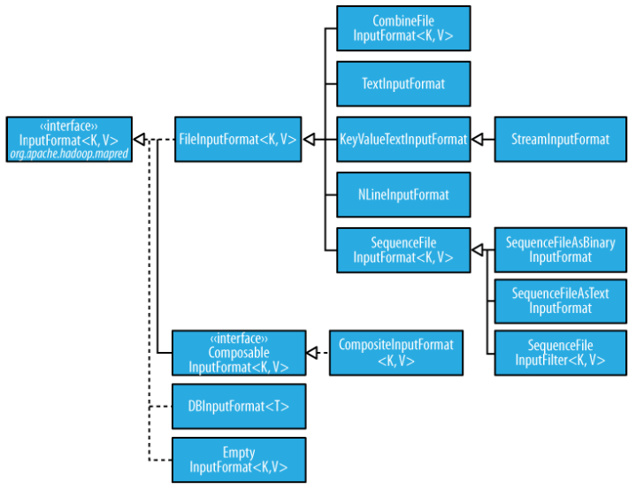

Slide 12
FileInputFormat – input paths
FileInputFormat – have 4 static methods to set job’s input paths.
addInputPaths(job,path), addInputPaths(job,commaseparated paths
setInputPaths(job,path), setInputPaths(job,commaseparated paths
Note that if the path provided is directory, and if it contains sub directories, the sub directories are considered as files, will cause error.
To avoid this use globs, so that only files are returned based on pattern.
Or set mapreduce.input.fileinputformat.input.dir.recursive to true.
addInputPaths can be called repeatedly to build the list of paths.
setInputPaths set the entire list of paths in one go, replaces any paths set on the job in previous calls.

Slide 13
FileInputFormat – input splits
Now you have set of files, how FIF turn them into splits?
FIF splits only large files that are larger than HDFS block.
You can increase or decrease split size. Optimum is block size.
mapreduce.input.fileinputformat.split.minsize – default 1 byte
mapreduce.input.fileinputformat.split.maxsize – Long.MAX_VALUE(very large value)
Dfs.blockSize – default 128MB
If the split size is increased, it will increase the no of blocks that are not local to map task.
Split size is calculated using the below formula(computeSplitSize() method in FIF)
Max(minimumSize,min(MaximumSize,blocksize)). So by default, below happens
E.g. Max(1byte,min(92233720….. , 128MB) ->max(1byte,128MB) results in 128 MB
So if you change block size this split size will change accordingly.

Slide 14
FIF - CombineFileInputFormat
Hadoop works better with small no of large files than large no of small files.
When there are too many small files, say 10000 files each 100KB then the FIF launces one map for each file, this makes the job very much slower due to overheads. (FIF generates one split per file)
Hence we use CombineFileInputFormat, packs many files into each split so that each mapper has more data to process.

Slide 15
How to process a whole file as a record?
Interview Question: How to process entire file as a record.
You need to have a custom implementation of RecordReader also set isSplitable() returns false.
Here we don’t use any key, the key will be NullWritable and values are file contents, represented by BytesWritable.

Slide 16
LAB
Write algorithm to read the whole file as a record.
Implement the custom record reader for the above problem.

Slide 17
FIF – Text Input
Text input is processing of unstructured text. Below are the InputFormats to process text in Hadoop.
TextInputFormat
It is the default InputFormat. Each record is line of input.
Key is LongWritable, it is the byte offset of the beginning of the line.
Value is the contents of the line (boundaries are new line or carriage return).
The value is packaged as Text Object.
E.g. – (0, hi hello how are you),(21, I am good, welcome)
We cannot have line no as key, because we can know the line numbers within a split, but not in the whole file.

Slide 18
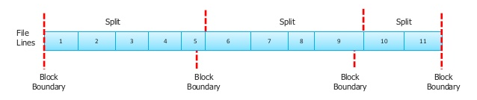
Relation between input splits and HDFS blocks
Some times, the record boundaries cross HDFS block boundaries.
But to process a record/line we need to read the entire line.
The part of the line (here line 5, exceeding the boundary) is fetched from another block.
The actual split is from line 1 to line 5, and second split starts from line 6, even though the split spans the first and second block.

Slide 20
KeyValueTextInputFormat:
TextInputFormat keys are just offsets within the file, and are not very useful.
To interpret files that contains lines as key – value pair, k,v are separated by a delimiter (e.g tab), we use the KeyValueTextInputFormat.
From prev examples we know that TextOutputFormat,(which is def output format) writes the file as key – value pair with tab delimiter.
The default separator in KVIF is TAB. You can configure using mapreduce.input.keyvaluelinerecordreader.key.value.separator property.
The e.g reads from a file are:
Line1->hi hello how are you , Line2->I am fine, welcome

Slide 21
NLineInputFormat:
For TIF and KVIF, each mapper receives a variable no of input lines.
This number depends on the size of the split and length of the lines.
If you want your mappers to receive a fixed no of lines of input, then we need to use the NlineInputFormat.
Keys are byte offsets and values ae the lines (like TIF).
N=1 by default, i.e each mapper receives exactly one line of input.
Mapreduce.input.lineinputformat.linespermap – property controls N.
E.g. use cases are , some applications(simulations) take a small amount of input data and run CPU intensive computations for it, then emit their output.

Slide 22
XML:
Most XML parsers operate on whole XML docs.
If a large XML document is made up of multiple input splits, it is difficult to parse them individually.
You can process the entire file as a record using one mapper.
Using simple string or regular expression, the large XML document can be broken into records, by finding the start and end tags of records.
Hadoop comes with a class to read the XML documents called ‘StreamXmlRecordReader’. It is in hadoop.streaming.mapreduce package.
You set your input format as StreamInputFormat and set stream.recordreader.class property to – org.apache.hadoop.streaming.mapreduce.StreamXmlRecordReader.
You specify these configurations in Job’s properties to tell the patterns start and end tags.

Slide 23
E.g. use case for XML is , Wikipedia provides dumps of its content in XML form, which can be processed in parallel using MR.
The data is contained in one large XML wrapper document, this contains series of elements such as page elements which contains content and associated metadata.
Using StreamXmlRecordReader, the page elements can be interpreted as records for processing by a mapper.

Slide 24
Binary Input
MR can process binary data, as good as it processes text data.
SequenceFileInputFormat:
Hadoop Sequence file format stores sequence of binary key-value pairs.
Sequence files are splittable, hence best suited format for MR data.
Sequence files have sync points. And this format supports compression as part of the format. This format can store any data type with any serialization frameworks.
SequenceFIleInputFormat can read both Sequence files as well as map files.
While reading map files, it uses the data file. Hence there is no separate MapFileInputFormat.

Slide 25
SequenceFileAsTextInputFormat: (variant of SFIF)
This InputFormat convers the sequence file’s key and values to Text objects.
Conversion happens by calling toString() on keys and values.
This format makes sequence files suitable input for streaming.
SequenceFileAsBinaryInputFormat: (variant of SFIF)
This retrieves the sequence file’s key and values as OPAQUE binary objects.
These are encapsulated as BytesWritable Objects.
This format provides a way to use binary data types with MR.
FixedLengthInputFormat:
It is for reading fixed-width binary records from a file, when the records are not separated by delimiters.
Record size is set via – fixedlengthinputformat.record.length.

Slide 26
Multiple Inputs
MultipleInputs allows you to specify, a InputFormat and Mapper to use on a per-path basis.
This arise when one file have tab delimited data and other input file have space delimited data. You need to run different mappers on each path(file). And these different data formats are to be parsed differently.
We use this Multiple Inputs in “Reduce-side Joins”
MultipleInputs.addInputPath(job,ncdcInputPath,TextInputFormat.class, MaxTempMapper.class);
MultipleInputs.addInputPath(job,metOfficeInputPath,TextInputFormat.class, MetOfficeTempMapper.class);
Here you can see that, the above line of code replaces FileInputFormat.addInputPath() and job.setMapperClass().

Slide 27
Database Input
DBInputFormat is an input format for reading data from a relational database, using JDBC.
This is best for loading relatively small data sets, perhaps for joining with larger datasets from HDFS using MultipleInputs.
The corresponding output format is DBOutputFormat, used to dump job output(of moderate size) into a database.
Prefer Sqoop than using this format for moving data to and from DB.
TableInputFormat – is HBase format allows MR program to operate on data stored in Hbase table. TableOuputFormat is for writing MR output into Hbase table.

Slide 28
Output Formats
Hadoop have Output data formats that correspond to input format.
Org.apache.hadoop.mapreduce.OutputFormat<K, V>
DBOutputFormat
FileOutoutFormat
NullOutputFormat
FilterOutputFormat -> LazyOutputFormat
FileOutputFormat
MapFileOutputFormat
SequenceFileOutputFormat
SequenceFileAsBinaryOutputFormat
TextOutputFormat
Notes:
https://hadoop.apache.org/docs/r2.4.1/api/overview-tree.html
<number>

Slide 29
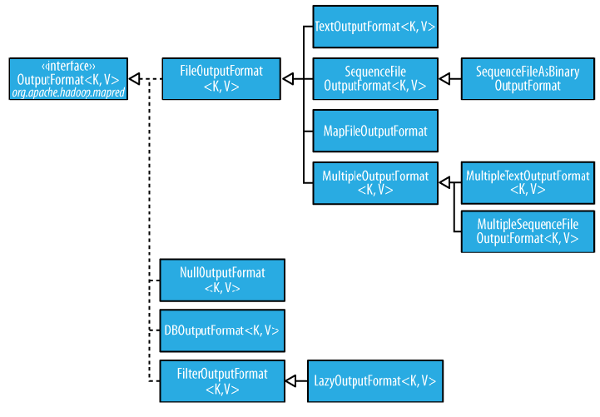

Slide 30
Text Output
TextOuputFormat is the default format, whose records are lines of text. And each Key-Value pair is separated by a tab character.
You can change the default delimiter by property.
Mapreduce.output.textoutputformat.separator
KeyValueTextInputFormat – breaks the lines into Key-Value pairs based on the configured separator.
You can suppress either key or value or both using the NullWritable (NullOutputFormat) type.

Slide 31
Binary Output
SequenceFileOutputFormat
This writes sequence files for its output.
Note this is good choice of output if it forms the input to a further MapReduce job.
This is because it is compact and readily compressed.
Compression is controlled via static methods on SequenceFIleOutputFormat.
LAB – how to use sequence File output format – See Sorting.
SequenceFileAsBinaryOutputFormat
This writes keys and values in raw binary format into a sequence file container

Slide 32
Binary Output .. cont..
MapFileOutputFormat
This writes map files as output.
Note that keys in MapFile must be added in order, so you need to ensure the reducer emit keys in sorted order.
Input to reducer are guaranteed to be sorted, but the output keys are under control of reduce function. Hence the reduce output keys have to be ordered in any way.

Slide 33
Lazy Output , Database Output
File output format and its subclasses will create output files(part-r-nnnnn) files, even of they are empty.
Some applications prefer not to create empty files.
The LazyOutputFormat – which is a wrapper output format that ensures the output file is created only when the first record is emitted for a given partition.
To use this format, use the JobConf.setOutputFormatClass() method.
DatabaseOutout formats writes data to a relational database and Hbase just like Database Input formats.

Slide 34
Multiple Outputs
FileOutputFormat and its subclasses generates set of files in the output directory.
One file per reducer and the files are named by the partition number
Part-r-000000, 000001 etc.
MultipleOutputs – class can give control over naming of the files or produce multiple files per reducer.

Slide 35
MultipleOutputs
This MultipleOutputs allows you to write data to files whose names are derived from the output key and values or from an arbitrary string.
This allows each reducer (or Mapper in map only job) to create more than a single file.
File names is of the form name-m-nnnnn for maps and name-r-nnnnn for reduce outputs.
Name is set by program and nnnnn is the part number starting from 00000.
This part number make sure that files from different mappers and reducers do not collide with each other incase of same name.

